Slide 1

Email and Message Spam Classification Using Transformer Models
K. Santosh (IDS-2300033358) & G. Sesha Sai (IDS-2300031722)

Slide 2

The Spam Challenge: Why Classic Filters Fall Short
Exponential Growth Problem
Traditional Models Struggle
The Need for Intelligence
Modern spam requires models that comprehend language deeply, recognizing contextual nuances and adapting dynamically to new deceptive patterns.
Spam emails and messages proliferate daily, creating serious security vulnerabilities and overwhelming user inboxes with frustration.
Classic approaches like Naive Bayes and SVM lack the sophistication to understand context and fail against evolving spam tactics with linguistic obfuscation.

Slide 3
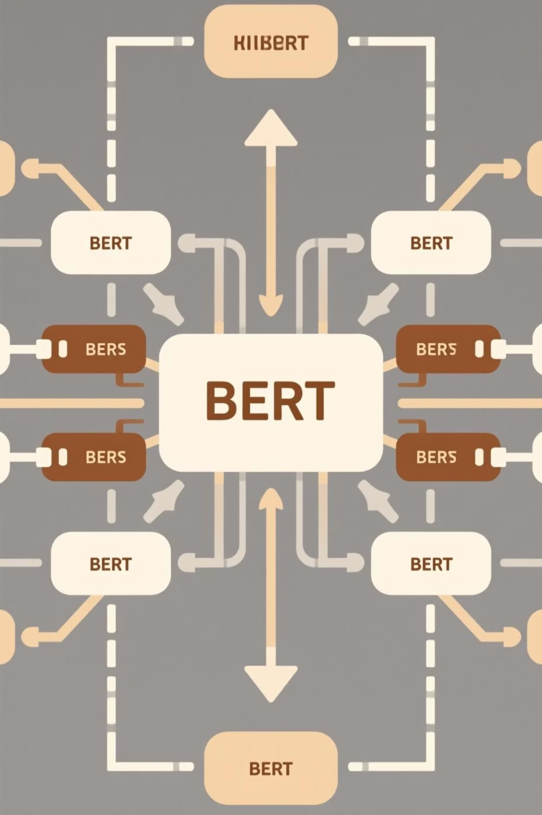
Enter BERT: Revolutionizing Text Understanding
What is BERT?
Why BERT Excels
Developed by Google, BERT (Bidirectional Encoder Representations from Transformers) fundamentally changed how machines understand language by processing context bidirectionally—examining words from both left and right simultaneously.
Unlike older embeddings such as Word2Vec and GloVe, BERT generates dynamic, context-aware representations. This enables superior detection of subtle linguistic cues that distinguish spam from legitimate messages.

Slide 4

Our Project Approach: Leveraging BERT for Spam Detection
01
02
03
Fine-Tuned Pre-trained Model
Attention Mechanism Utilization
Transfer Learning Strategy
Leveraged BERT base uncased model, fine-tuned specifically on the Enron email dataset to classify messages as spam or legitimate ham with contextual understanding.
Applied transfer learning to dramatically reduce training time and improve accuracy despite limited labeled data, leveraging pre-existing linguistic knowledge.
Harnessed multi-head attention layers to capture intricate semantic relationships and dependencies within email text, revealing hidden patterns.

Slide 5


Model Architecture and Workflow
Tokenization
Attention → Classification
Input Text
BERT Embedding
Key Components
Optimization Focus
Tokenization breaks input into processable units
Rigorous hyperparameter tuning balanced precision and recall to minimize false positives—ensuring critical emails never end up in spam folders.
BERT embeddings create context-rich representations
Multi-head attention weights semantic importance

Slide 6

Performance Highlights
98%
0.99
99%
Accuracy
F1-Score
Precision Rate
Achieved on Enron email dataset with exceptional reliability
Exceeding baseline benchmarks for balanced precision-recall
Minimal false positives protecting legitimate messages
Key Achievement: Our BERT-based model significantly outperformed traditional machine learning approaches and baseline deep learning methods, demonstrating the transformative power of modern transformer architectures for spam classification tasks.

Slide 7

Why Transformers Outperform Traditional Methods
Long-Range Dependencies
Robustness to Tactics
Self-attention captures relationships across entire documents, understanding context spanning hundreds of words—impossible for older models.
Generalizes exceptionally well across diverse writing styles, obfuscation techniques, and evolving spam deception patterns.
Minimal Feature Engineering
Learns sophisticated linguistic features directly from raw text, eliminating tedious manual feature extraction required by traditional methods.

Slide 8

Real-World Impact and Applications
Immediate Benefits
Future Expansions
Dramatically reduces inbox clutter and user frustration
SMS spam and mobile message filtering
Substantially decreases phishing attack risks
Social media message moderation platforms
Enhances overall email security and user experience
Advanced phishing and cybercrime detection systems
Indian Context: With cybercrime cases surging dramatically across India, robust spam detection supports critical national cybersecurity infrastructure and protects millions of users.

Slide 9

Challenges and Future Directions
Current Challenges
Hybrid Innovation
Imbalanced datasets with skewed spam-to-ham ratios and continuously evolving sophisticated spam tactics require ongoing refinement and adaptive strategies.
Exploring advanced architectures combining BERT embeddings with Graph Neural Networks to capture relational context between messages and senders.
Explainability Research
Incorporating interpretability techniques like attention visualization to understand model decisions and build stakeholder trust in automated systems.

Slide 10

Conclusion & Acknowledgements
Key Takeaway
Transformer-based models like BERT dramatically elevate spam classification accuracy, robustness, and adaptability compared to traditional machine learning approaches.
Project Success
Demonstrated practical, real-world application with impressive results on authentic email datasets, validating the effectiveness of our approach.
Presented by:
K. Santosh (IDS-2300033358)G. Sesha Sai (IDS-2300031722)
We welcome your questions, insights, and engaging discussion.

